Slide 1
Policy Comparison of California and New York states – Covid-19 Containment
DATA 698 – Final Project for CUNY MSDS
Deepak Mongia
29-Nov-2020

Slide 2
Introduction
Covid-19 had varied impact over different geographies of the world
Different states within the US had different overall impacts, some were impacted badly, and some were able to contain Covid-19 really well
New York had a very high surge and was worst affected in the intial phase - March and April, but then NY was able to control te Covid-19 spread - May onwards
California was under control until May end, and then had huge surge from May until August

Slide 3
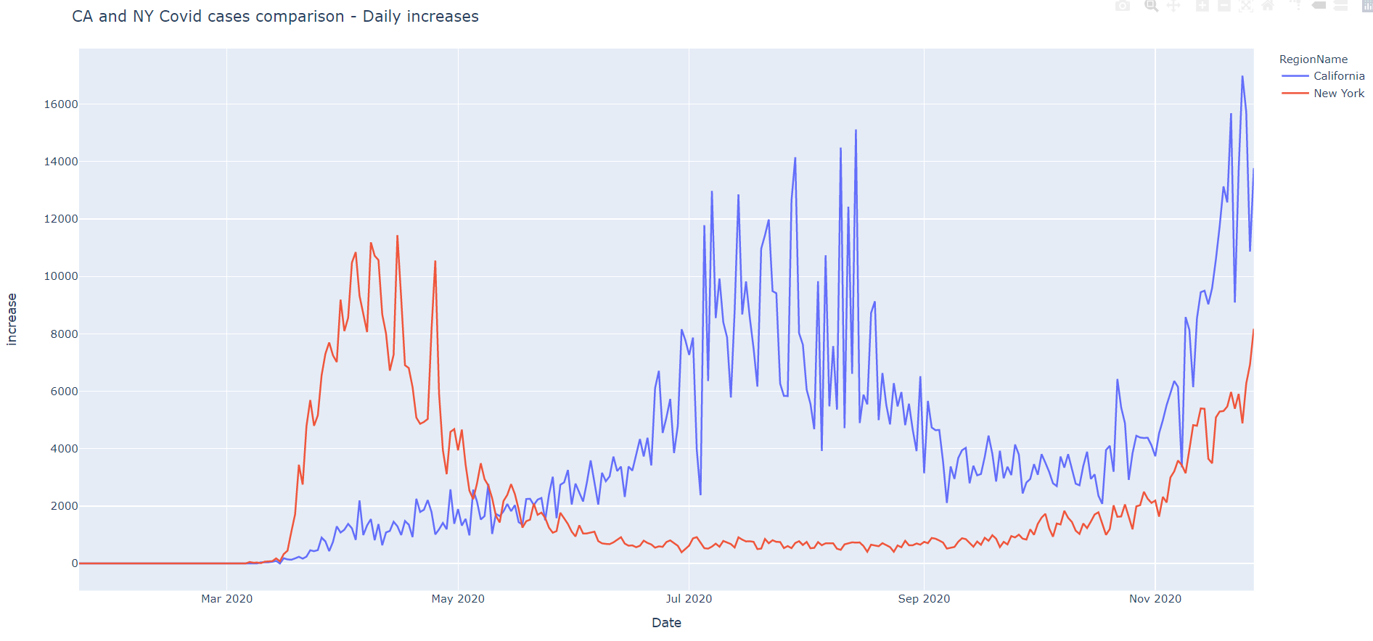
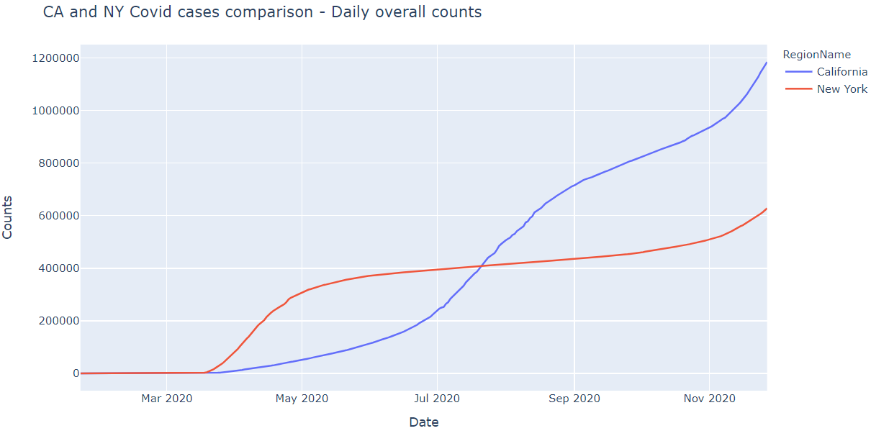
Comparison Plots
- New York and California had a distinctive trend in the Covid-19 cases spread over spread

Slide 4
Question we are dealing with
What was the main difference in the government policies in the 2 states – related to Covid-19 ?
What really caused California to have a very high jump in the Covid-19 cases from June onwards ?

Slide 5
Literary Review
Variation in government responses to COVID-19
Mobilizing Policy (In)Capacity to Fight COVID-19: Understanding Variations in State Responses
COVID-19 and the policy sciences: initial reactions and perspectives

Slide 6
Literary Review - contd.
Most of the literary papers we found point to the overall policy measure addition for the states or countries, and don't talk about individual policies
OxCGRT - Oxford Covid-19 Government Response Tracker Paper suggests how the policy indicators can be used for further analysis and reseacrh
Papers also talk about the timings of the policies adopted by various governments and how these timings impacted the overall impacts in those states or countries

Slide 7
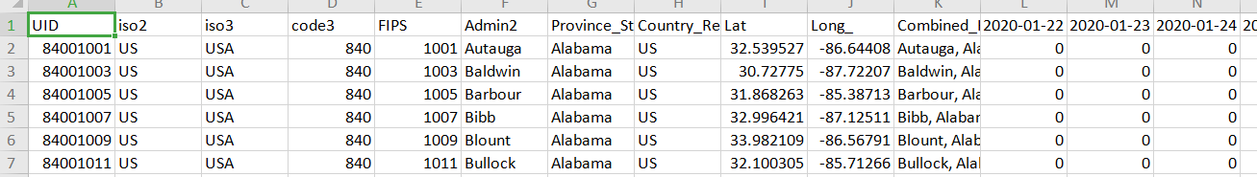
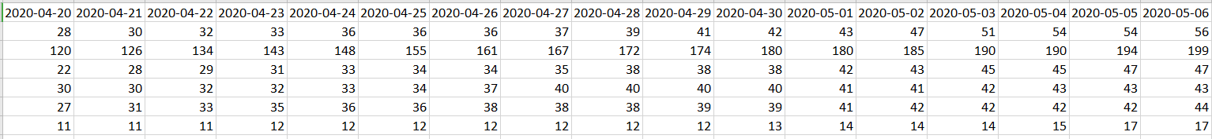
Data used
JHU CSSE COVID-19 Dataset:

Slide 8
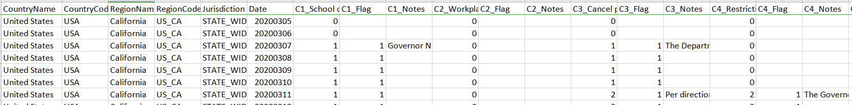
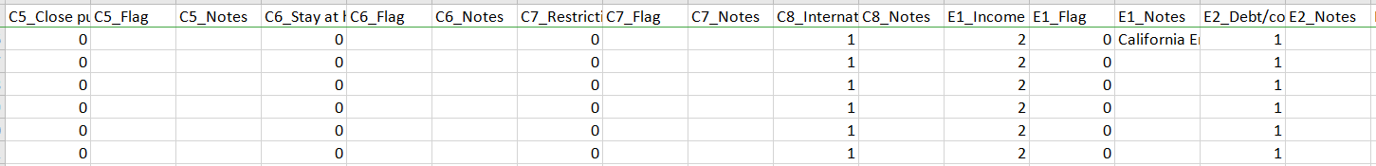

Data Used - contd.
Oxford Covid-19 Government Response Tracker (OxCGRT)
3 types of policy indicators:

Slide 9
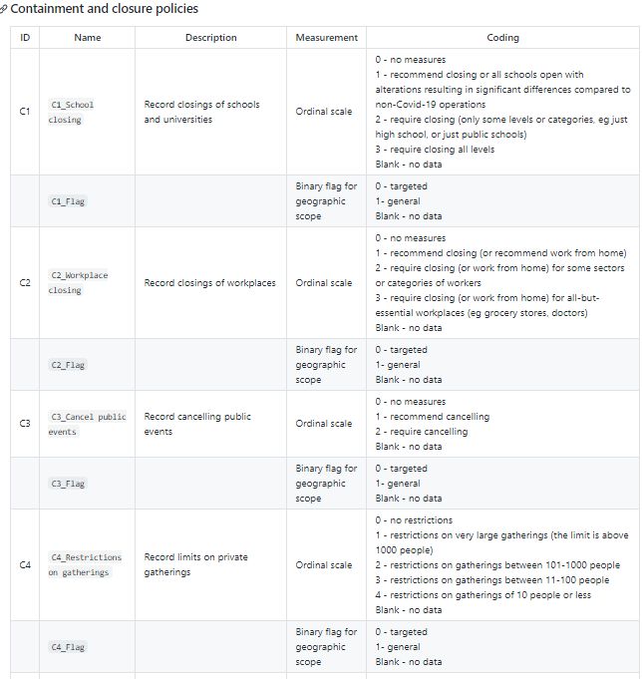
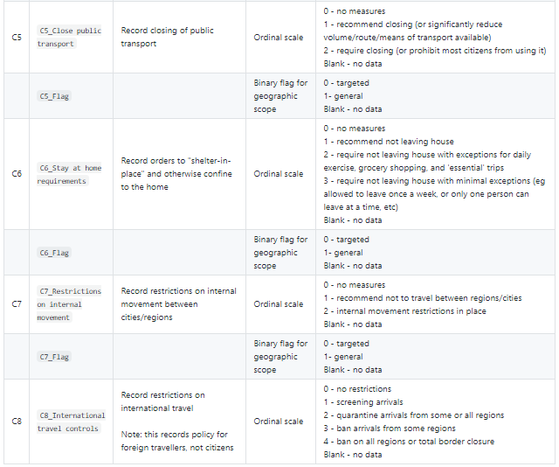
Data used - contd.
OxCGRT

Slide 10
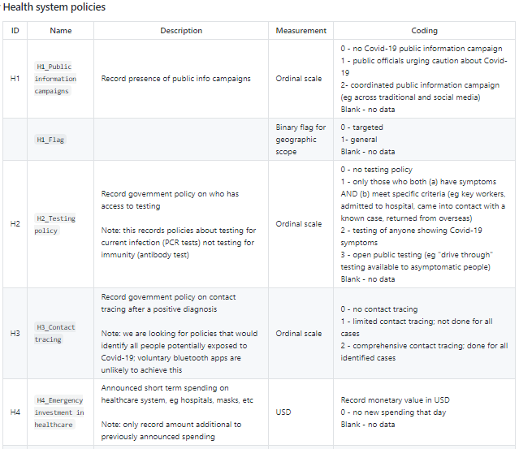
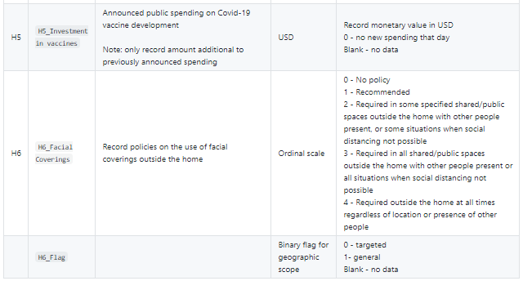
Data used - contd.

Slide 11
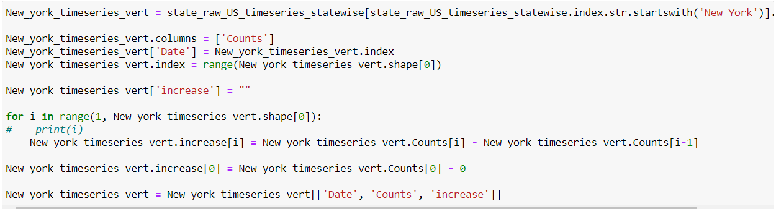
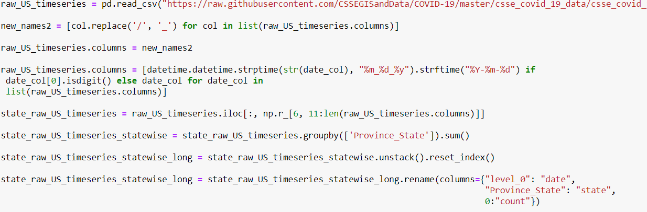
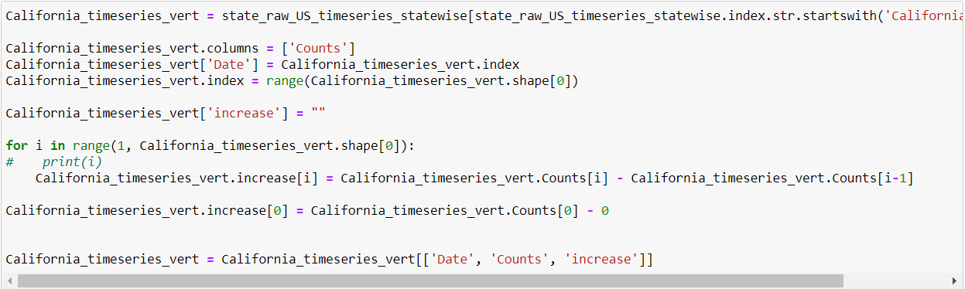
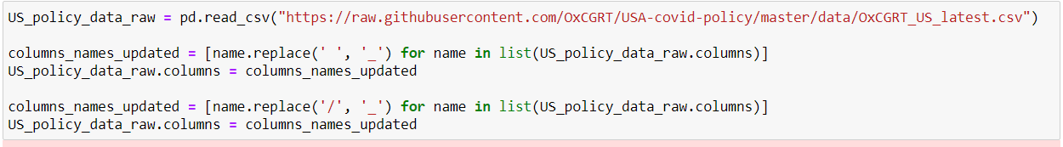
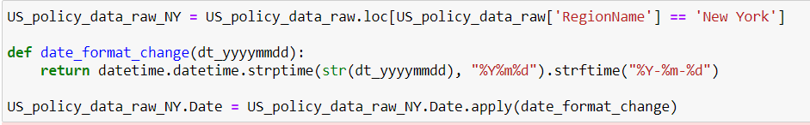
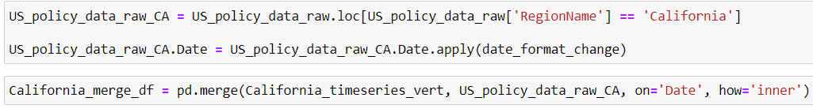
Data Cleansing and imputation

Slide 12
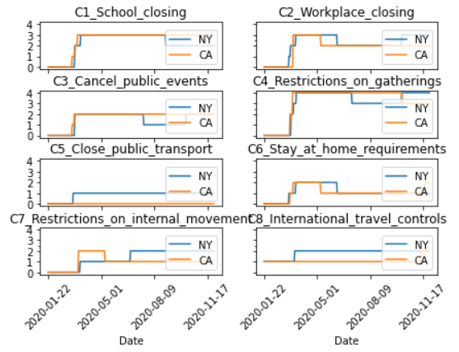
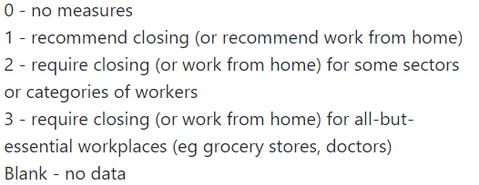
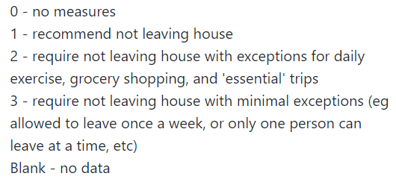
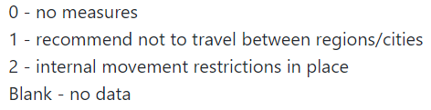
Policy Comparison Plots
Major containment and closure policy differences
Workplace closing - California moved from a value 3 to 2 on 8-May, while New York was with value 3 until 8-Jun and then moved back to 3 on 8-Oct
Stay at home requirement - indicator moved from value 2 to 1 on 8-May, while New York had this value as 2 until 8-Jun
Restrictions on internal movement - indicator moved from 2 to 1 on 8-May, while for New York, this indicator was 1 until June end and then moved to value 2
C2_Workplace closing
C6_Stay at home requirements
C7_Restrictions on internal movement

Slide 13
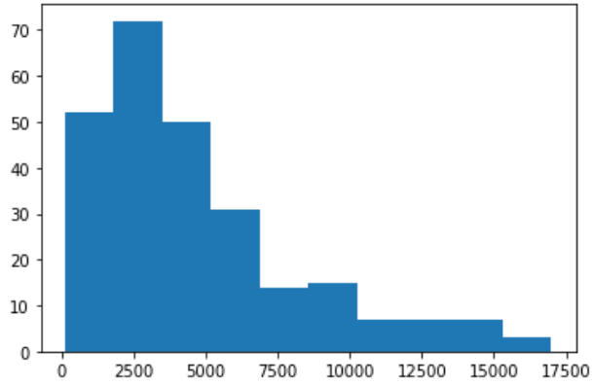
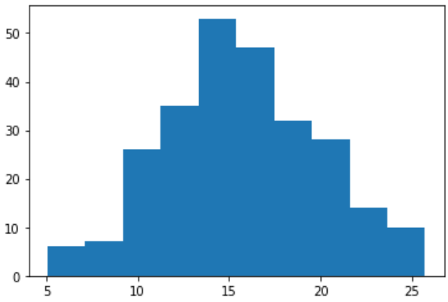
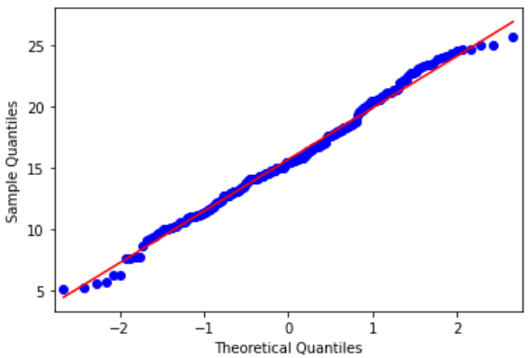
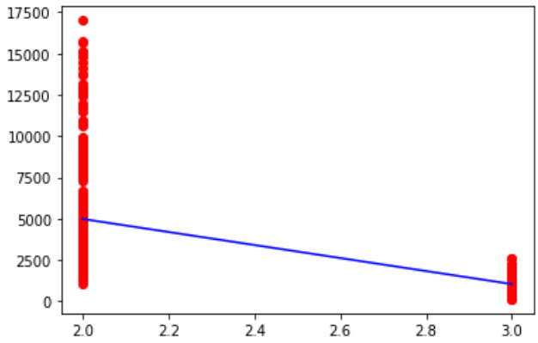
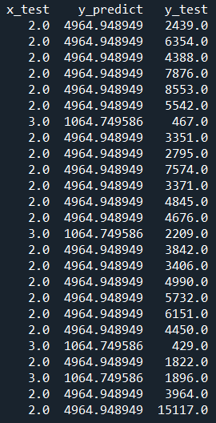
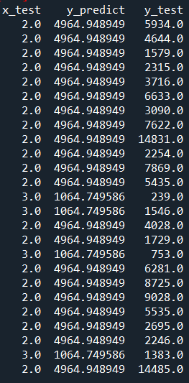
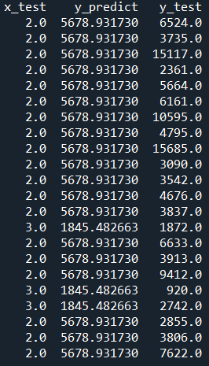
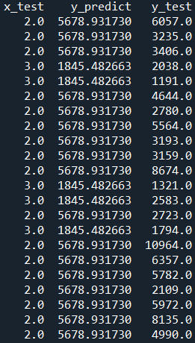
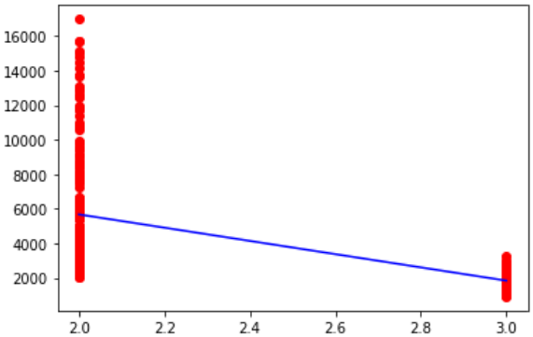
Statistical Models tried
Linear Regression Model
Cube root
transformation
plt.hist(California_merge_df_model_try2.increase)
plt.hist(np.cbrt(California_merge_df_model_try2.increase.astype(np.float)))
Covid-19 Increase vs C2_Workplace_closing - Non-lagged
Covid-19 Increase vs C2_Workplace_closing - lagged by 28 days
R-squared = 0.3398
Linear Regression - NOT a good fit here

Slide 14
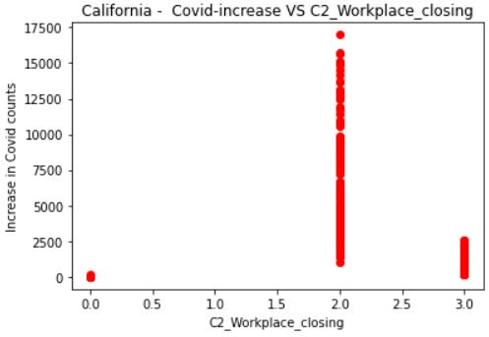
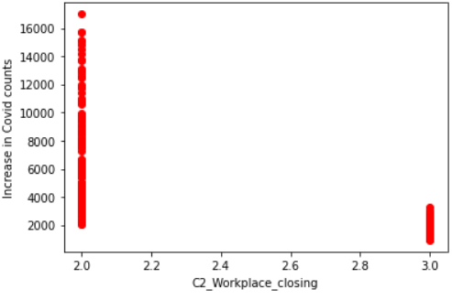
Statistical Models tried - contd. - Correlation
Non-parametric Correlation - does not require the dependent or the independent or both variables to follow any particular distribution.
Here we are using Spearman's Rank correlation
coef, p = spearmanr(California_merge_df_model_try2.increase, California_merge_df_model_try2.C2_Workplace_closing)
coef, p = spearmanr(California_merge_df_model_try2.increase, California_merge_df_model_try2.C2_Workplace_closing_lag*)
C2_Workplace_closing
C2_Workplace_closing | C2_Workplace_closing - lag 14 days | C2_Workplace_closing - lag 17 days | C2_Workplace_closing - lag 20 days | C2_Workplace_closing - lag 23 days | C2_Workplace_closing - lag 25 days | C2_Workplace_closing - lag 28 days
-0.668 | -0.692 | -0.698 | -0.700 | -0.693 | -0.696 | -0.699

Slide 15
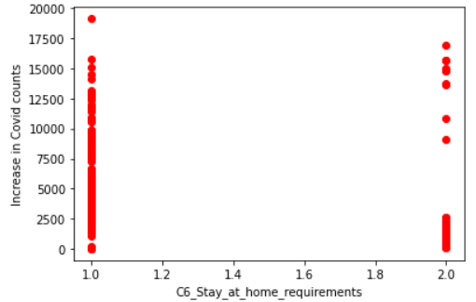
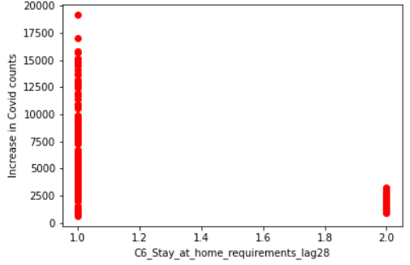
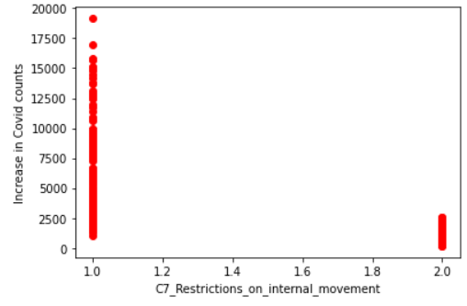
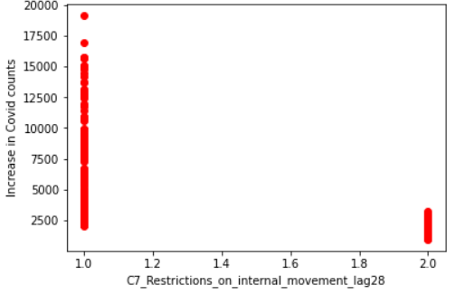
Statistical Methods - contd.
C6_Stay_at_home_requirements
C6_Stay_at_home_requirements | C6_Stay_at_home_requirements - lag 14 days | C6_Stay_at_home_requirements- lag 17 days | C6_Stay_at_home_requirements - lag 20 days | C6_Stay_at_home_requirements- lag 23 days | C6_Stay_at_home_requirements - lag 25 days | C6_Stay_at_home_requirements- lag 28 days
-0.456 | -0.647 | -0.656 | -0.663 | -0.655 | -0.657 | -0.653
C7_Restrictions_on_internal_movement
C7_Restrictions_on_internal_movement | C7_Restrictions_on_internal_movement- lag 14 days | C7_Restrictions_on_internal_movement - lag 17 days | C7_Restrictions_on_internal_movement - lag 20 days | C7_Restrictions_on_internal_movement - lag 23 days | C7_Restrictions_on_internal_movement - lag 25 days | C7_Restrictions_on_internal_movement - lag 28 days
-0.659 | -0.683 | -0.689 | -0.692 | -0.684 | -0.687 | -0.691

Slide 16
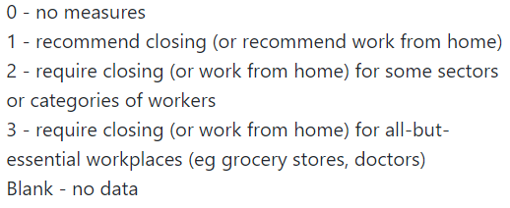
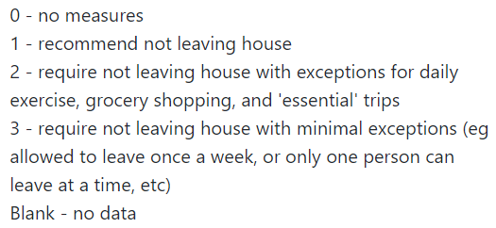
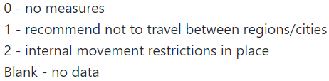
Conclusions
Major differences in containment / closure policies between NY and CA which caused California Covid-19 cases to surge:
C2_Workplace_closing
C6_Stay_at_home_requirements
C7_Restrictions_on_internal_movement_lag28
Covid-19 increase has a very strong correlation with the following 3 containment and closure policies:
C2_Workplace_closing
C6_Stay_at_home_requirements
C7_Restrictions_on_internal_movement_lag28

Slide 17
Assumptions
Covid-19 increase in cases on a given day is independent of the increase in cases of the previous day
For data imputation, assumption is that for the missing data of the policy indicators, the values would be same as the nearest value (date wise) for the same policy indicator
While doing statistical analysis for relationship between the Covid-19 counts and each policy indicator considered, the assumption is that the other policy indicators remained the same
There can be many other factors like below which impacted the Covid-19 counts in any given area. Those factors not considered here, with the assumption that those remain the same while evaluating these indicators considered.

Slide 18
Future Works
Further research can be performed using the same data to understand what are the major factors statistically which are causing New York cases to rise up again.
What measures from the international travel restrictions would have helped both the states and even the overall US to contain the virus spread (effect of C8_International travel controls) - compared to other countries like New Zealand which was able to contain the virus really well with this indicator on 4 ?
Evaluate Texas policy indicators compared to the 2 states of NY and CA.

